Slide 1


Medicine Recommendation System
A Personalized Health Assistant
Presented by:
AMAN SINGH
DEEPANSHU DHAKA
SHIVAM DHAKA
ABHINAV CHAUDHARY

Slide 2

Introduction
Objective:
To assist users by providing probable disease information based on their symptoms.
Recommend appropriate precautions and medication.
Problem Statement:
Many people struggle to identify the right treatment and precautions for common illnesses.
This system provides guidance without requiring immediate doctor visits for minor issues.

Slide 3
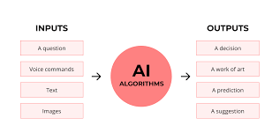
Program Flow
1. Symptom Input:
User enters their symptoms.
2. Disease Prediction:
System analyzes symptoms and suggests possible diseases.
3. Precaution & Medication Suggestions:
Provides recommendations for medications and preventive measures.

Slide 4
CHARACTERISTICS
Symptom-Based Diagnosis:
Uses keywords and symptom matching for quick analysis.
Precautionary Advice:
Lists preventive actions to avoid further complications.
Medication Recommendations:
Suggests over-the-counter medications where applicable.
User-Friendly Interface:
Simple, interactive UI for ease of use.

Slide 5
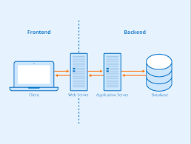
System Architecture
Frontend:
User Interface for symptom input and result display.
Backend:
Disease analysis algorithm.
Medication and precaution database.
Data Sources:
Medical databases, symptom-disease
correlation, medication information.

Slide 6
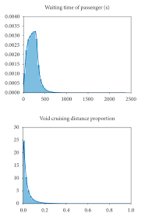
Disease Analysis Process
Symptom Matching Algorithm:
Maps input symptoms to known symptom-disease sets.
Condition Probability Check:
Calculates likelihood of diseases based on symptom combinations.
Response Time:
Aimed at quick and responsive user feedback.

Slide 7
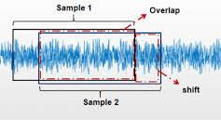
Challenges and Solutions
Data Accuracy:
Challenge: Ensure reliable information.
Solution: Using verified medical data sources.
Symptom Overlap:
Challenge: Similar symptoms in
multiple diseases.
Solution: Implementing a weighted
scoring algorithm for accuracy.

Slide 8

Future Scope
Machine Learning Integration:
Improve prediction accuracy with learning models.
Mobile Application:
Expand reach and accessibility.
Expanded Database:
Broaden symptom-disease relationships
for better coverage

Slide 9
Conclusion
Summary:
Medicine Recommendation System as a valuable tool for health guidance.
Impact:
Simplifies initial diagnosis and provides preliminary care information

Slide 10


